Slide 1
Machine learning 101 Session 3

Slide 2
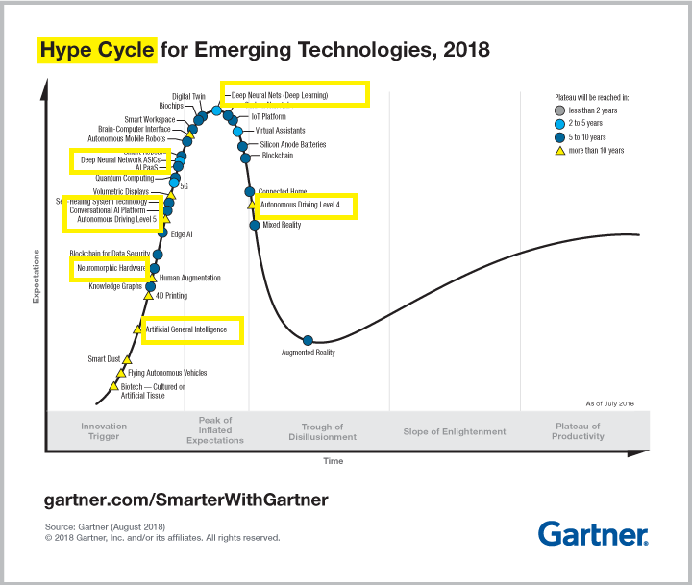
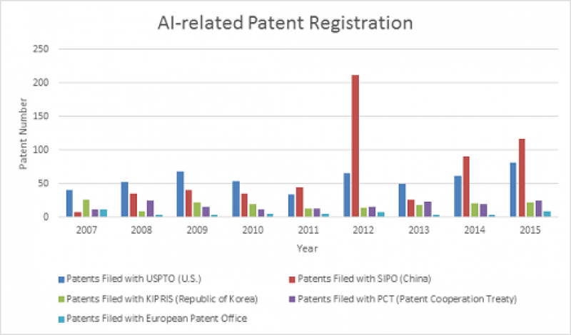
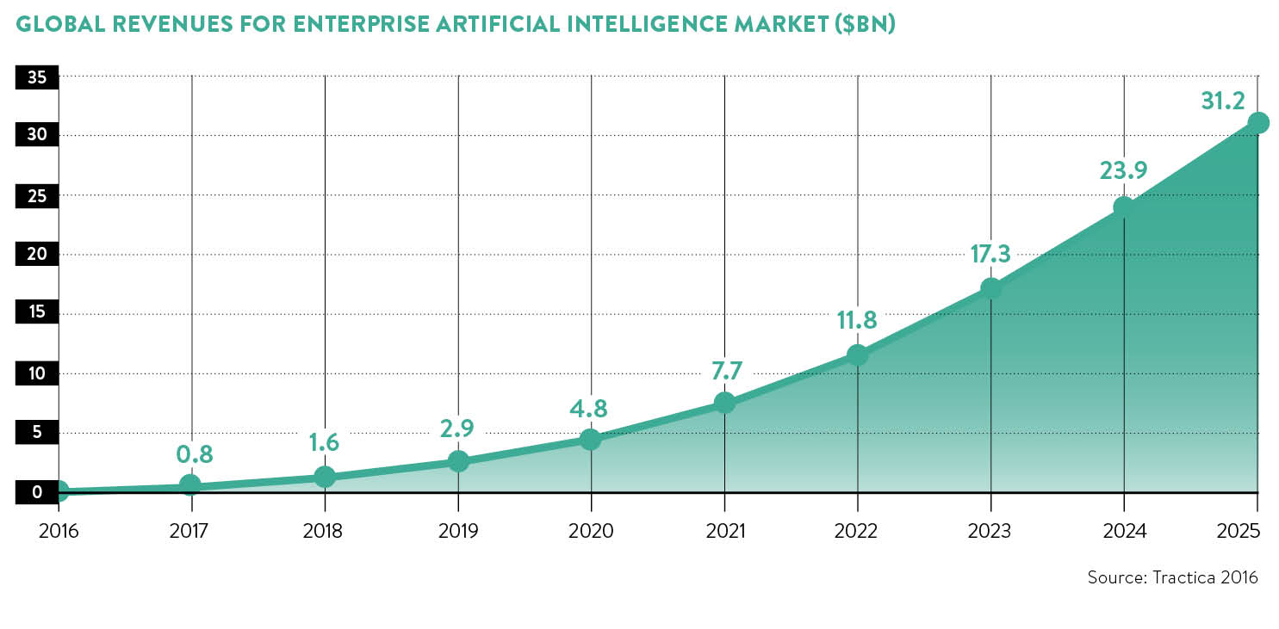
ML: Business Impact

Slide 3
Web application of ML: extraction
Take an input HTML file, return the reading view
Get rid of noise / boilerplate
Current algo is heuristic based, need ML algorithm

Slide 4
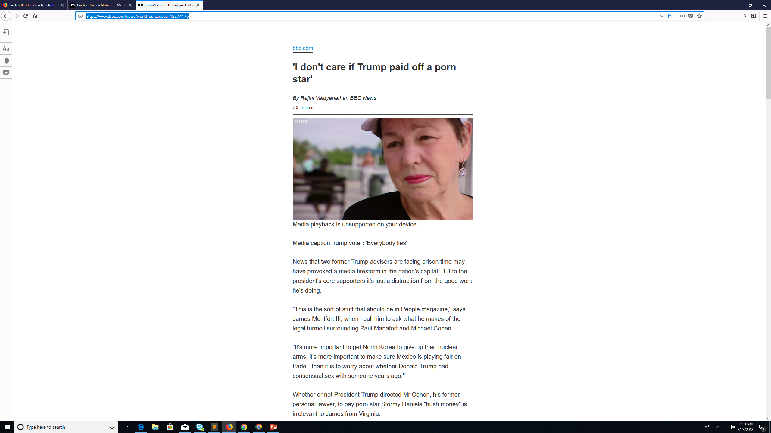
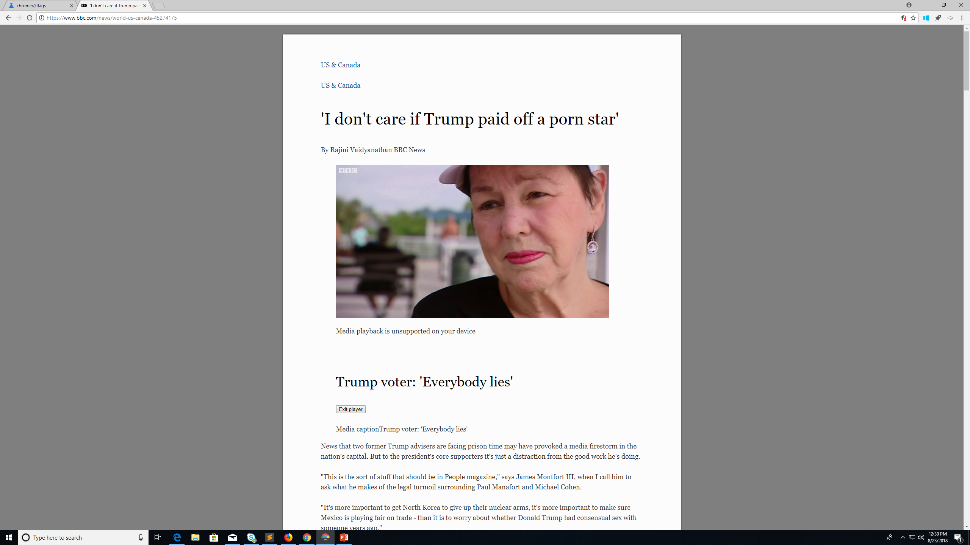
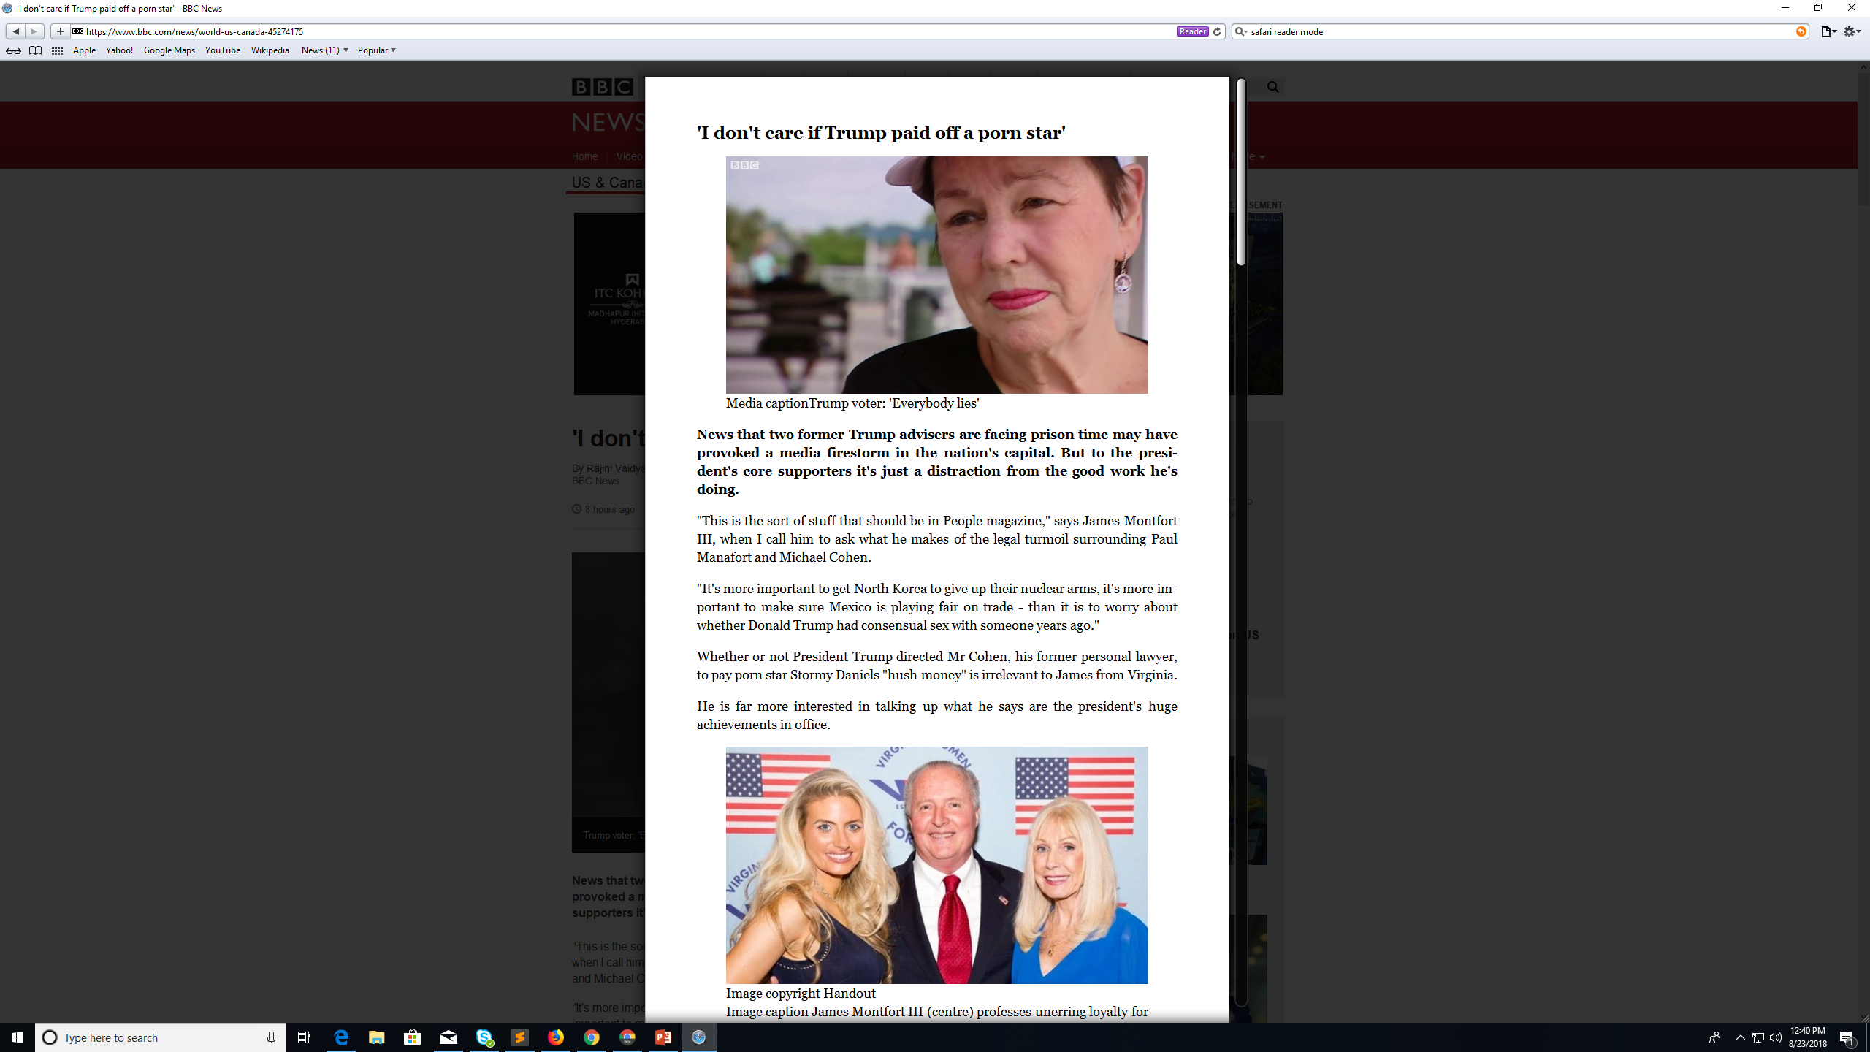
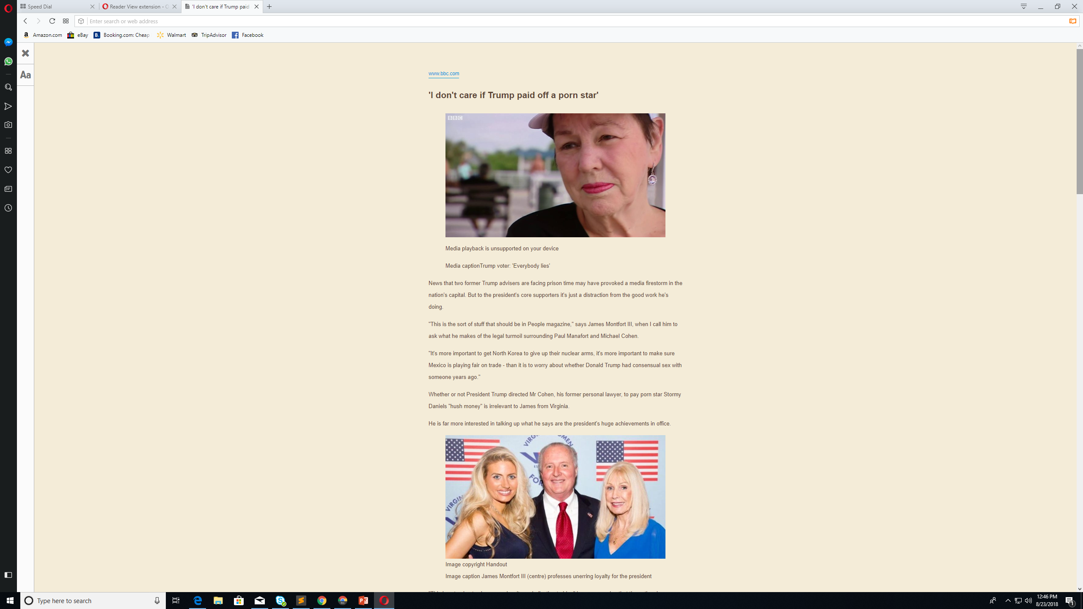
Reading View in browsers
Firefox
Chrome
Safari
Opera

Slide 5
Reading View: Related Work in papers
Paper on Boilerplate detection using shallow text features (Kohlschutter , WSDM 2010) http://www.l3s.de/~kohlschuetter/publications/wsdm187-kohlschuetter.pdf
PhD thesis on detecting boilerplate, chapter 2 is particularly relevant: https://is.muni.cz/th/o6om2/phdthesis.pdf?so=nx
Paper on DOM based content extraction using text density method, published in SIGIR 2011: http://www.ofey.me/papers/cetd-sigir11.pdf
A recent 2018 paper on boilerplate removal using HMM (hidden markov model): https://arxiv.org/pdf/1801.02607.pdf
Paper by Google engineer on removing boilerplate to cast webpages on small screen devices, published in WWW 2006: http://www.esprockets.com/papers/www2006-2502-baluja.pdf

Slide 6
Approaches in related work Boilerplate removal/ content extraction/ web page segmentation
Text Density
Extract content of webpages by text density (noise is highly formatted, content is more text less formatting)
DOM tree
Leverage DOM tree structure and jointly analyze webpages from same domain to detect template content across pages
Smoothening
Break down HTML into 0s (text) and 1s (HTML tags). Smoothen to find regions where text dominate vs where tags dominate
Block level SVM
Use SVM to independently classify blocks

Slide 7
Available Datasets of annotated webpages
CleanEval
https://cleaneval.sigwac.org.uk/
Has annotated webpages corresponding to news articles
L3S-GN1 Google news dataset
https://github.com/geodrome/page-signal
Dragnet dataset
https://github.com/seomoz/dragnet_data

Slide 8
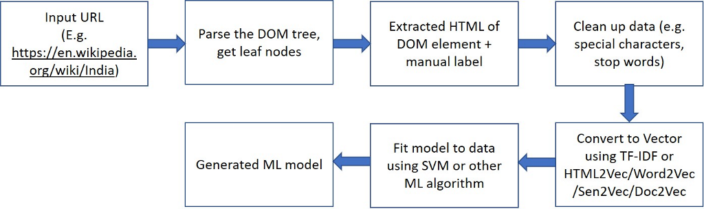
High level overview

Slide 9
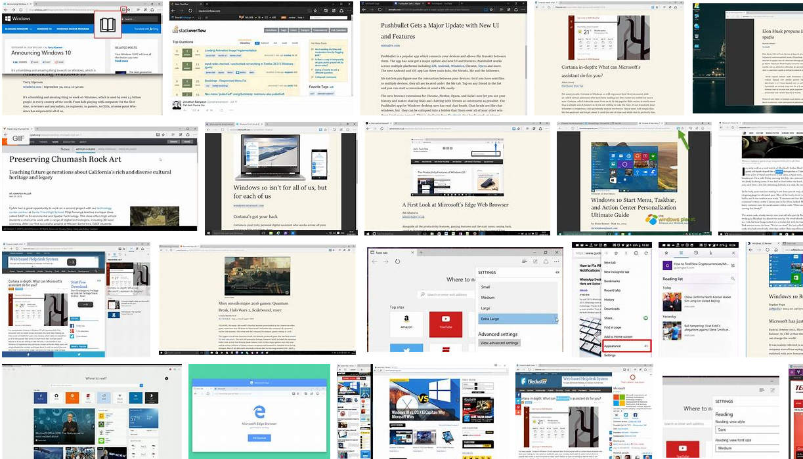
ML use case: Reading View
Collect data from different webpages, label it (data or noise), train a ML model on the server
Input features can be visual features from renderer, tag density, element frequency, text density, link density, heuristics, position of element, context (frequent words used), Html2Vec/Word2Vec/TF-IDF vector embeddings of content
Download the trained model on the client PC/mobile.
HTML Code | Label
< ...Snippet 1 ..></Snippet 1> | Data
< ...Snippet 2 ..></Snippet 2> | Noise
< ...Snippet 3 ..></Snippet 3> | Data
< ...Snippet 4 ..></Snippet 4> | Noise
Algo
E.g. SVM
Trained Machine learning model
Labelled data
HTML pages

Slide 10
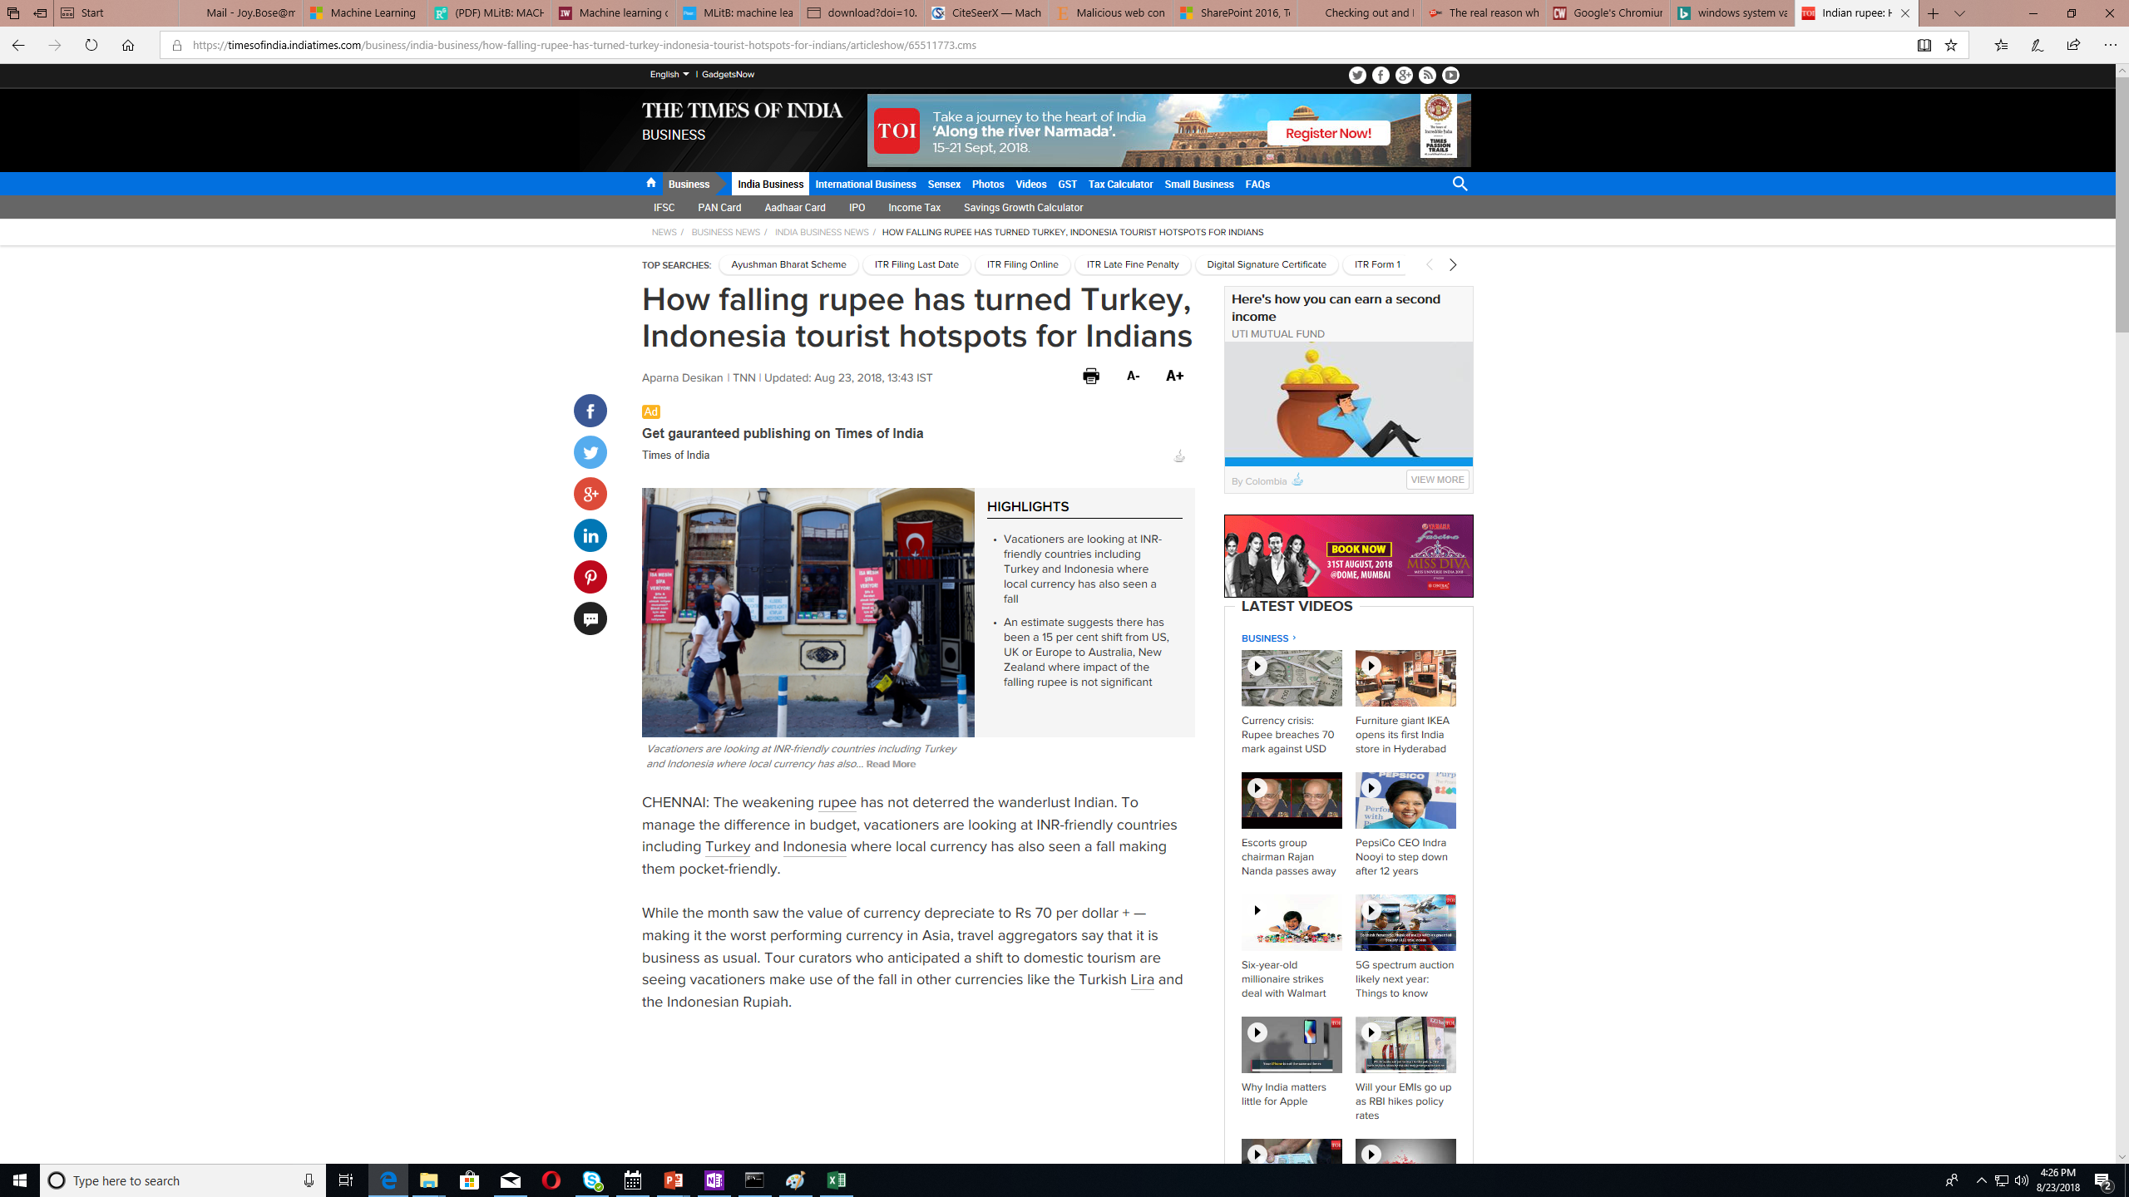
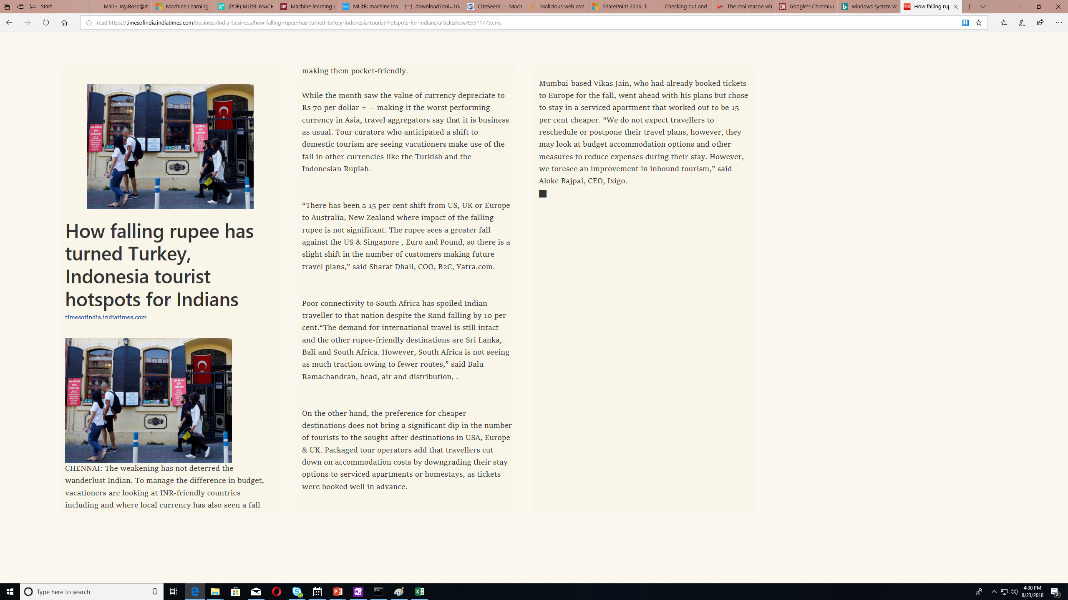
ML use case: Reading View (continued)
When the browser loads a new webpage, it passes each HTML snippet to the trained model
The trained model then classifies the HTML snippet and labels it as ‘Data’ or ‘Noise’
The Reading View then decides whether to render the snippet
HTML
Trained Machine learning model
Web Browser
Label
(data/noise)
Original HTML page
Reading
View

Slide 11
Reading View ML Implementation
Create a labelled dataset of <HTML snippet, label> tuples
Train SVM or any other ML model on server (break dataset into training set + validation set + test set, train on training set, refine on validation, test on test set to get accuracy) using PY/Java/C++ code
Download trained model and C++/JAR file on the client and call the APIs
Client should call ML libraries (e.g. libSVM or tensorflow etc) to execute the prediction steps OR implement the library functions as part of client code
Latency should be < acceptable threshold

Slide 12
How to get a ML solution for extraction
It is a classification problem → Classify each DOM element as noise or content
First step is to create a labelled dataset of <features, label>
Features can be: number of words, number of links, text density, link density, position of the element, link density of previous element etc
HTML Code | Label
< ...Snippet 1 ..></Snippet 1> | Data
< ...Snippet 2 ..></Snippet 2> | Noise
< ...Snippet 3 ..></Snippet 3> | Data
< ...Snippet 4 ..></Snippet 4> | Noise
Algo
E.g. SVM
Trained Machine learning model
Labelled data
HTML pages

Slide 13
1. Create dataset
1000 HTML pages from Mozilla Firefox test bed
Parse each page using BeautifulSoup Python library
Break each page into <p> tags (add more tags later)
Compute text density, word count, link density etc from each p block
Write to dataset CSV file as vector
//files/en-US_converted/3d-car-shows.com_899c907926f3ad6a4db1de243f4bd5fb.htm,26,0,0,0,1.0,0.0
//files/en-US_converted/3d-car-shows.com_fc5ac5346350c9b360b3724c20b6a86b.htm,47,0,0,0,1.0,0.0
//files/en-US_converted/49ers.pressdemocrat.com_94cd26b23cf2a686c25c80b2a37388d9.htm,28,0,0,1,0.97,0.03
//files/en-US_converted/620wtmj.com_a3c777abce9c44b20fca6c2a08d3470f.htm,6,0,0,2,0.75,0.25
//files/en-US_converted/9and10news.com_28ab5357f7888f347ae4c329c95d8453.htm,28,0,0,0,1.0,0.0
//files/en-US_converted/9news.com_b766c07e450f2651236b45bb4aa0cd0d.htm,2,0,0,0,1.0,0.0

Slide 14
2. Label dataset
For each line in the dataset, manually label as 1/0 (content or noise)
Can use an automated tool for the purpose
<p>According to Matt Maiocco, Ahmad Brooks will count $2.85 million against the 49ers’ salary cap in 2012. For all the figures of Brooks’ deal, <a href="http://www.csnbayarea.com/blog/niners-talk/post/Brooks-deal-counts-285-million-against-2?blockID=661356&amp;feedID=2800">read Matty’s article here</a>.</p>
html file found: 49ers.pressdemocrat.com_94cd26b23cf2a686c25c80b2a37388d9.htm
Number of words = 28
number of links and inputs and scripts= 1
link density = 0.034482758620689655
text density = 0.9655172413793104
//files/49ers.pressdemocrat.com_94cd26b23cf2a686c25c80b2a37388d9.htm,28,0,0,1,0.97,0.03, 1 (label)

Slide 15
3. Train SVM model and save to disk
Take labelled dataset CSV file
Train linear SVM model and save to disk
df = pd.read_csv(dataset_path,
header=None,
names=['url',
'word_count',
'input_count',
'script_count',
'link_input_script_count',
'text_density',
'link_density',
'label’])
X = df[df.columns[1:7]]
y= df[df.columns[7]] #predicted value
x_train, x_test, y_train, y_test = train_test_split(X, y, test_size=0.2, random_state=0)
print('Result with linear SVM')
linearsvm = svm.LinearSVC()
linearsvm.fit(x_train, y_train)
save_model_pickle(linearsvm, model_pickle_filename)

Slide 16
4. Predict for a fresh webpage
Parse webpage using BeautifulSoup
1
Extract features for each p block
(Word count, link density, text density)
2
Use SVM predict function to predict the output (1 / 0 for content / noise)
3
Write fresh HTML page → Include p block if it is content, ignore if noise
4

Slide 17
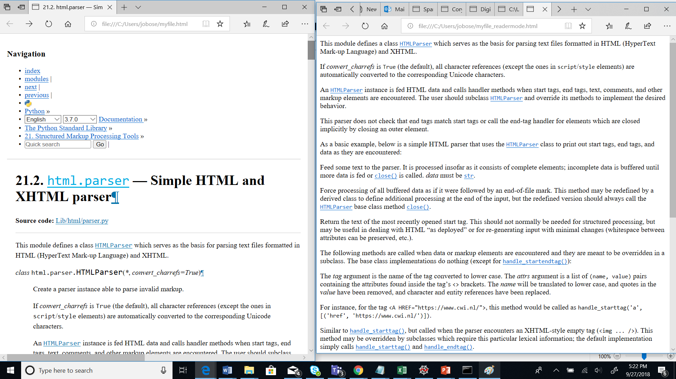
Example Result

